Slide 1
Opening Restaurant in London
Coursera Capstone Project

Slide 2
Table of Content
Business Problem
Methodology and Data
Exploring London Neighborhoods
Exploring London Restaurants
Results
Discussion
Conclusion

Slide 3
1. Business Problem
According to www.food.gov.uk, there are more than 14,000 restaurants in London and about 9 million people. That is why opening a new restaurant there can be an extremely challenging task. According to several surveys, up to 40% of such start-ups fail in the very first year. Let's suppose, an investor has enough time and money, as well as a passion to open the best eating spot in London. What type of restaurant would it be? What would be the best place for it?
Target audience: investors, entrepreneurs, and chefs interested in opening a restaurant in London, who may need a piece of objective advice of what type of restaurant would be more successful and where exactly it should be opened.

Slide 4
2. Methodology and Data
Step 1. Using a table on https://en.wikipedia.org/wiki/List_of_areas_of_London, collect information about London boroughs and locations, excluding records whose "Post Town" is not London.
Step 2. Use the Geopy and Folium library to get the coordinates of every locations and map geospatial data on a London map.
Step 3. Using Foursquare API, collect the top 100 restaurants and their categories for each location within a radius 500 meters.
Step 4. Group collected restaurants by location and by taking the mean of the frequency of occurrence of each type, preparing them for clustering.
Step 5. Cluster restaurants by k-means algorithm and analyze the top 10 most common restaurants in each cluster.
Step 6. Visualize clusters on the map, thus showing the best locations for opening the chosen restaurant.

Slide 5
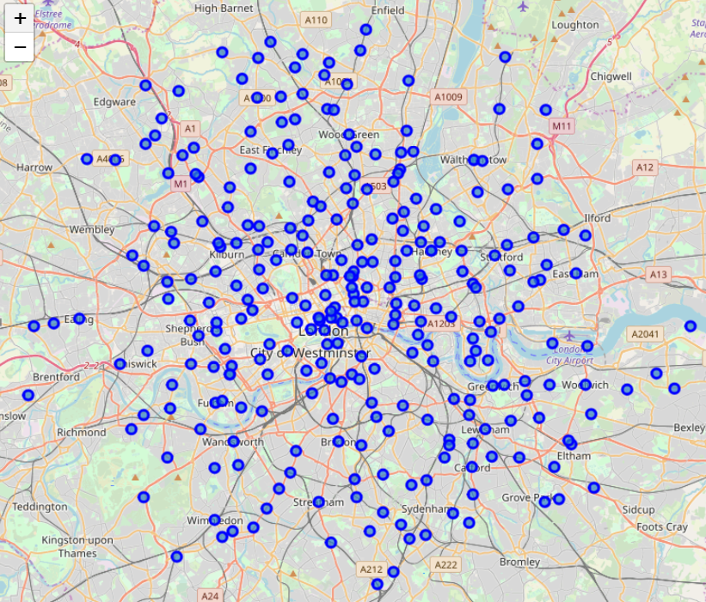
3. Exploring London Neighborhoods
Using Wikipedia we collected all London neighborhoods.
Using geospatial libraries we add geographical coordinates.
We had made some cleaning and wrangling, thus we obtained 288 locations in London.

Slide 6
4. Exploring London Restaurants
We utilized the Foursquare API to get the top 100 restaurants in each neighborhood.
Thus we obtained 6273 restaurants of 126 unique types.
We had applied one-hot encoding and grouped them using by taking the mean of the frequency of occurrence of each type.
Then we clustered restaurants using the k-means algorithm.

Slide 7
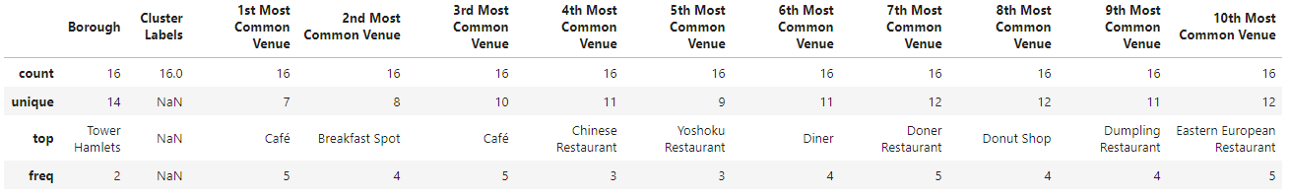
5. Results
Cluster #1.
The most common restaurant: Café.
The 10th most common restaurant: Eastern European Restaurant.

Slide 8
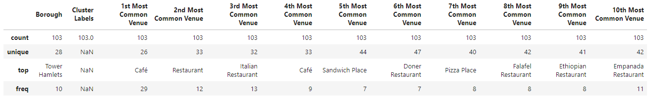
5. Results
Cluster #2.
The most common restaurant: Café.
The 10th most common restaurant: Empanada Restaurant.

Slide 9
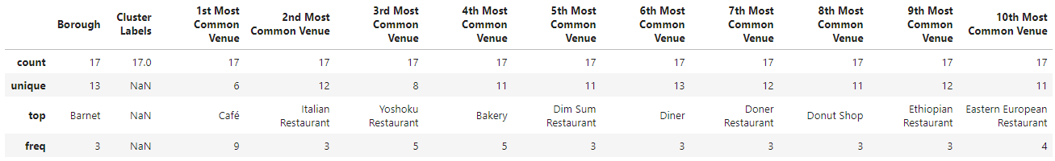
5. Results
Cluster #3.
The most common restaurant: Café.
The 10th most common restaurant: Eastern European Restaurant.

Slide 10
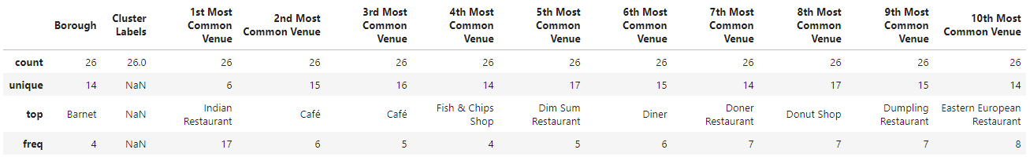
5. Results
Cluster #4.
The most common restaurant: Indian Restaurant.
The 10th most common restaurant: Eastern European Restaurant.

Slide 11
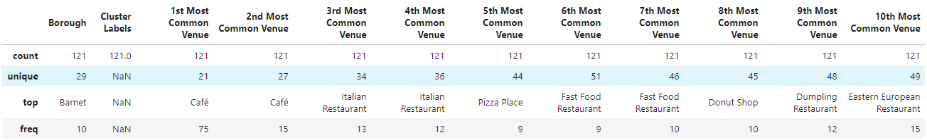
5. Results
Cluster #5
The most common restaurant: Café.
The 10th most common restaurant: Eastern European Restaurant.

Slide 12
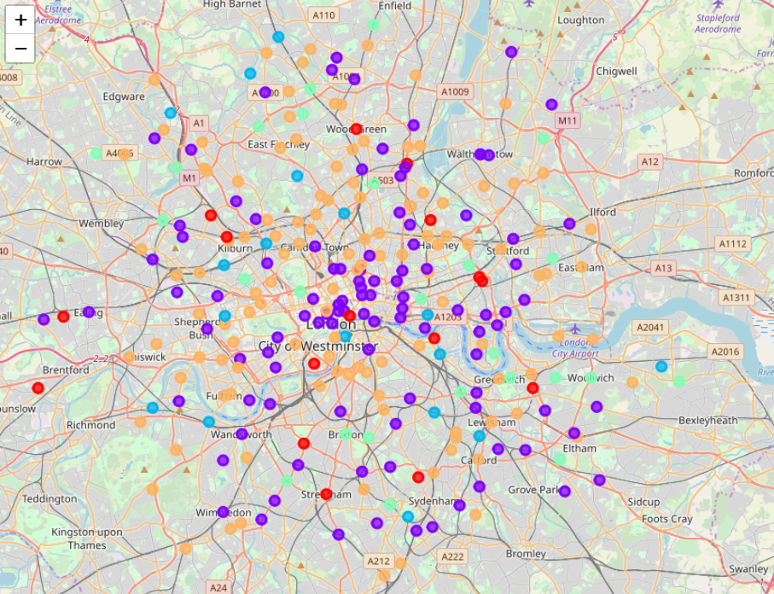
5. Results
Visualizing Clusters
Cluster 1 - red
Cluster 2 - purple
Cluster 3 - blue
Cluster 4 - green
Cluster 5 - orange

Slide 13
6. Discussion
Analyzing the most popular restaurants in each cluster, the stakeholder should prefer the least popular types as a safe choice. That is why in our recommendations we offer to select 10th or 9th positions.
Recommendations, based on description of each cluster:
Cluster 1 Locations: Eastern European or Dumpling Restaurant
Cluster 2 Locations: Empanada or Ethiopian Restaurant
Cluster 3 Locations: Eastern European or Ethiopian Restaurant
Cluster 4 Locations: Eastern European or Dumpling Restaurant
Cluster 5 Locations: Eastern European or Dumpling Restaurant
After the type of restaurant is chosen, it is time to select a right place. Using the final map its legend the solution is quite obvious.

Slide 14
7. Conclusion
In this report we worked out a methodology to determine what the most promising type of restaurant is and where it should be opened.
This type of analysis can be applied to any city of your choice that has available geospatial information.
This type of analysis can be applied to any type of venue (shopping, clubs, etc.) that is available in Foursquare database.

